Slide 1
From Samson to Xandra
If you don't know where you are going, any road will take you there. - Lewis Carroll

Slide 2
What is Samson?
The core of Samson was code developed for TACMs Software in the Loop project.
Furthered the distributed simulation effort for MEADS.
Baselined and revised on industry trends, using Open Source projects to build upon.
Allows developers to concentrate on math modes, not networking protocols.

Slide 3
How does it work for Xandra?
The core samson elements (Simulation Dispatcher, Model Interface Container and Message Interfaces) are independent of the systems being simulation.
The Simulation Dispatcher is meant minimize the number of connections and support both binary-by-wire as well as type-safe runtime control.
Their core functionality needs to be hardened and certain areas (e.g., Pub/Sub and Runtine control) need to be fleshed out. For example, on MEADS Corba was the candidate for providing type safe runtime control, but acceptane of Web Services is growing.
Written to Standards, rather than packages!

Slide 4
Industry change in focus
From networking standards, to network centric computing
INTERNETWORKING ARCH
MIDDLEWARE ARCH
RTP
TFTP
FTP
HTTP
Middleware
Applications
DNS
TELNET
UDP
TCP
Middleware
Services
IP
Middleware
Fiber Channel
Solaris
VxWorks
Ethernet
ATM
FDDI
Win2K
Linux
LynxOS
20th Century
21st Century
Demonstrated by: J2EE, Dot-Net, Grid Computing, Gamer LAN Parties, …

Slide 5
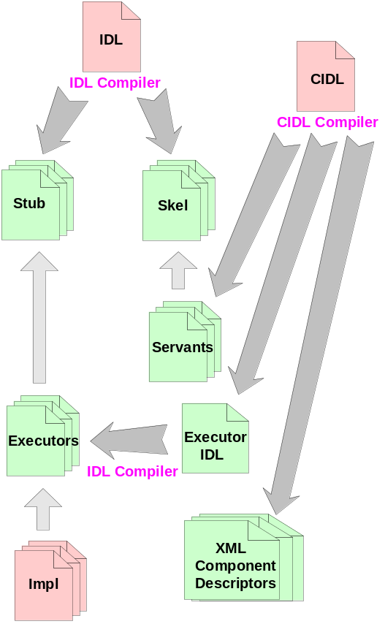
The current Grail vision …
... are Component Container model, such as J2EE Netbeans or CORBA Component Model (illustrated). These consists of a compiler, packaging, deployment, and runtime container.
Component
Component
Reference
Reference
Container
Container
Component
Component
Home
Home
COMPONENT
t
s
COMPONENT
t
s
x
e
x
e
F
l
F
l
a
EXECUTORS
e
c
a
EXECUTORS
e
c
t
a
t
a
c
n
t
c
n
t
e
o
p
e
o
p
t
s
C
e
t
s
C
e
s
l
e
t
c
s
l
e
t
c
a
c
n
e
a
c
n
e
n
a
e
R
n
a
e
R
r
f
r
f
e
r
n
s
e
r
n
s
t
e
o
t
t
e
o
t
n
t
p
e
n
t
p
e
S
E
I
n
n
c
S
E
I
n
n
c
i
v
I
m
e
r
i
v
I
m
e
r
n
e
o
v
u
n
e
o
v
u
k
n
Callback
C
E
o
k
n
Callback
C
E
o
s
t
Interfaces
S
s
t
Interfaces
S
POA
POA
ORB
Transaction
Persistent
Security
Notification
COMPONENT SERVER 1
COMPONENT SERVER 2

Slide 6
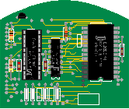
Middleware Options
Binary-thru-Socket
  Perceived as fastest as there is no management structure
Dot-Net
  Current market hype leader, middle level perception, but hotel and airline reservation systems are proving it viable.
J2EE
  Perceived business centric but used for very large integration products
CORBA-Tao
  Mature design spec for sharing data over remote procedure calls
Applications
Sensors
Domain-Specific
Services
Common
Services
Distribution
Middleware
Infrastructure
Middleware
Operating
System
Endsystem

Slide 7
Desired Distributed Object Technologies Core Features
Services Description
Naming Provides the ability to bind a name to an object. Similar to other forms of directory service.
Event Supports asynchronous message-based communication among objects. Supports chaining of event channels, and a variety of producer/consumer roles.
Lifecycle Defines conventions for creating, deleting, copying and moving objects.
Persistence Provides a means for retaining and managing the persistent state of objects.
Transaction Supports multiple transaction models, including mandatory "flat" and optional "nested" transactions.
Concurrency Supports concurrent, coordinated access to objects from multiple clients.
Relationship Supports the specification, creation and maintenance of relationships among objects.
Externalization Defines protocols and conventions for externalizing and internalizing objects across processes and across

Slide 8
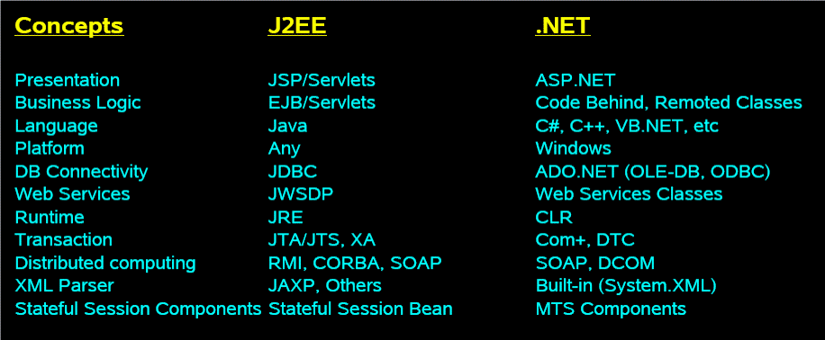
Features of Current Middleware Giants

Slide 9
One simple computing node…
Single Dispatcher on one each node coordinates communications between nodes and models
Dispatcher
Computing
Node
Internal communications can be fastest possible (shared memory, unix sockets, pipes)
Interface code is provided by architecture
Model
Model
Model
Models are insulated from the network and are “contained” via inheritance

Slide 10
… vs many nodes…
Non-Persistent command channel for runtime reconfiguration
Use of dispatcher reduces overall communication sockets (based on nodes, not models)
Persistent data connections lower overhead
LAN/WAN
Dispatcher
Dispatcher
Dispatcher
Model
Model
Model
Model
Model
Model
Model
Model
Model
Models for any job are split across nodes, grid engines for cluster submission are maturing well.
Job 1
Job 2

Slide 11
… with core services …
Some External Tools on
Specialized Nodes
Some Services are just like models
LAN/WAN
Dispatcher
Dispatcher
RDBMS
Dispatcher
Model
Model
Master
App
Exec
Random
Numbers
Model
Logger
Plotting

Slide 12


… that are scalable for speed …
Command Connection for runtime changes
Multiple Data Connections based on priority and
Using a thread pool for processing
Computing
Node
Scripting Language
Embedded for logic
Embedded
SQL for Routing
Modular
Dispatcher
XML Configuration Files
Filters
Internal connections per OS and served by thread
Model
Model
Model
Model
Model
Interface
Serial, GPIB, 1553, …

Slide 13
… as well as fidelity …
Models with different levels of fidelity as desired
LAN/WAN
Dispatcher
RDBMS Cluster
Dispatcher
RDBMS Cluster
RDBMS Cluster
6dof
3dof
Detailed
Coupled
Radar
Characterized

Slide 14
Current Samson Sample
Rudimentory event queuing and coordination
App Controller
Target
Missile
Target
Missile
Target
MFCR
Missile
SR
TOC
Launcher
RDMS
VatLog
A relational database holds the model interactions.
This is another Samson Model Peer, but it does not participate in the simulation, only listens and collects data. It then creates a file for visualizing the run.

Slide 15
System Trades
CORBA vs Web Services for command
ACE vs Boost for support libraries
Package management for client distribution
Real-time graphing
External layout/planning tools
…

Slide 16
Technology Gaps
C++ Object Persistence
  Attempts to use different persistence mechanisms have all failed. The problem often worked using Preprocessor Macros to do object reflection. We are working around it, but a product similar to Java’s serializable or “hibernate” product would be very useful to allow to simplify object distribution.
State Engine Processor
  One issue with distributed simulation is “repeatability”. Usually this is caused by messages not arriving consistently in a compute frame. While a good State Engine Processor will not ensure that, it can significantly improve the probability of success. Currently the best mode for this is in the “Ptolomey” product that is written in Java.

Slide 17
Technology Opportunities
CORBA
  As the overseer program suite (Job Manager, Event Queuing, Performance monitoring, …) is developed using CORBA for interacting between the components show promise. This allows features like type safety, object/platform independence, RDBMS decoupling.
Sun Grid Engine
  This will be used to distribute the jobs to the computers. As performance details are collected on the various sub-systems this information can be used to clue the engine how to allocate the resources.

Slide 18
Business Opportunities
System/Subsystem testing
  This is done by ensuring that data collection can be “inserted” into a simulation.
Synthetic Environments
  This is done by being able to plug in different fidelity level models
Algorithm Development
  This has many facets that need to come together….data insertion, Matlab code insertion, Software case tool interaction encapsulation.
Regression Testing
  This again has many facets, the biggest is to create an auto mated system for collecting and replaying simulation data on a given component.

